Slide 1


Introduction to Data Science
Supraja Rapuru

Slide 2
Agenda
Executive Summary
Data Science Simplified
Data Science History
Big Data
Business Applications
Q&A

Slide 3
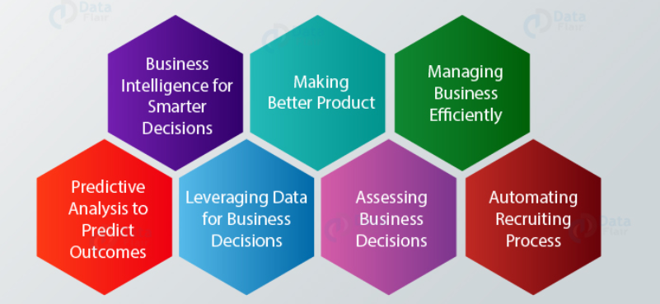
Executive Summary – Data Science Powers Business Value
Data Science is about creating positive impact to organization using data-driven approach rather knowledge drive approach
Data Science is about creating positive impact to organization using data-driven approach rather knowledge drive approach
Data Science used for better decision making i.e. whether A or B, predictive analysis i.e. what will happen next and pattern discovery i.e. is there any hidden information in the data?
Airbnb uses data science to improve its services The data generated by the customers, is processed and analyzed. It is then used by Airbnb to address the requirements and offer premier facilities to its customers
Walmart, Amazon are personalizing the shopping experience by analyzing the preferences and behavior of the customers. Using data science, it tracks the purchasing patterns of the customers and recommends them further products and discounts to improve their shopping experience
Source: Data Flair
Apple uses data science for its Apple watch to predict the risk of heart attack for customers by collecting data such as heart rate, sleep cycle, breathing rate, activity level, blood pressure

Slide 4
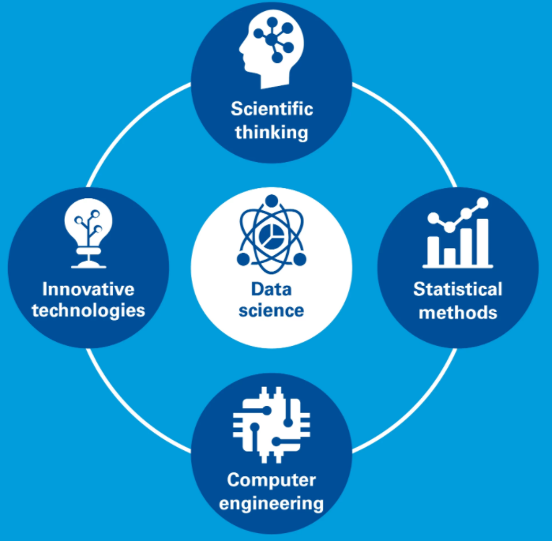
Data Science Simplified
Data science is a multidisciplinary approach that brings together scientific thinking, statistical methods, computer engineering, and innovative technologies to collect, combine, and assess significant amounts of structured and unstructured data in ways that can provide better insights and predictions to help answer business questions and drive strategic decisions.
Data might include historical and forecasted market data, industry benchmarks, economic outlooks, population and demographics data, aggregated location data from smartphone apps, satellite data, phone usage data, data from social media sites, and others.
Source: KPMG

Slide 5
Data Science History – Abundance of data i.e. Big Data sparked the rise of Data Science
Data mining in an article called from ‘Data mining to knowledge discovery in databases’ in 1996 in which referred to the overall process of discovering useful information from data
1966
William S. Cleveland wanted to bring data mining to another level. He did that by combining computer science with data mining. Now you can take advantage of computer power for statistics and he called this combo as data science
2001
Web2.0 emerged where websites are no longer just a digital pamphlet but a medium to shared experience among millions and millions of users. These are websites like myspace in 2003, Face book in 2004 and YouTube in 2005. We can now interact with these websites meaning we can contribute post, comment, like, upload, share. Leaving our footprint in the digital landscape and that’s lot of data, it became too much to handle using traditional technologies. So we call this Big Data. That opened a world of possibilities in finding insights using data.
2003
The rise of big data in 2010 sparked the rise of data science to support the needs of the businesses to draw insights from their massive unstructured data sets. With new abundance of data, it made possible to train machines with a data-driven approach than rather than knowledge driven approach. Something that can change the way we live and how we experience things in the world.
2010 onwards

Slide 6
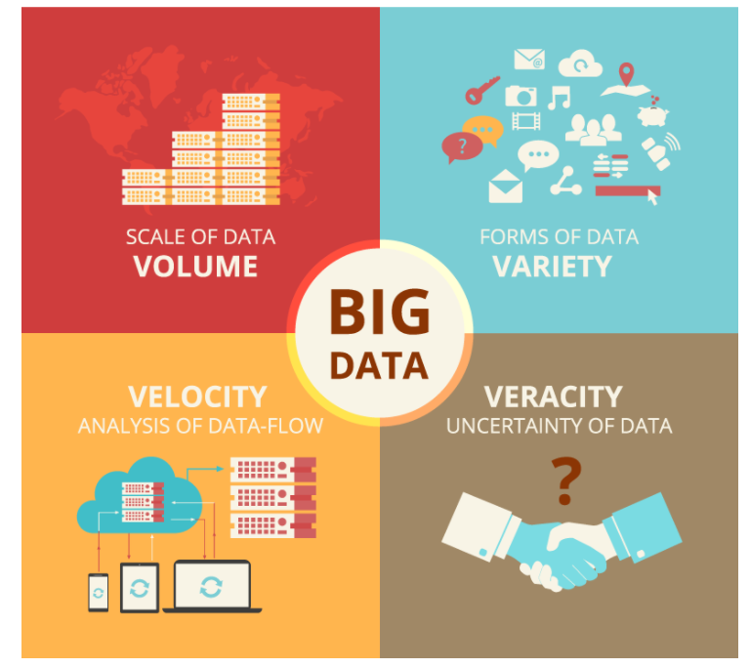
Big Data - Massive amounts of data that may involve complex, unstructured data, as well as semi-structured data
What industry leaders say about Big Data:
Gartner – Big Data is the new Oil.
IDC – Its market will be growing 7 times faster than the overall IT market.
IBM – It is not just a technology – it’s a Business Strategy for capitalizing on information resources.
IBM – Big Data is the biggest buzz word because technology makes it possible to analyze all the available data.
Big data use cases from different domains:
Netflix Uses Big Data to Improve Customer Experience
Promotion and campaign analysis by Sears Holding
Sentiment analysis
Customer Churn analysis
Predictive analysis
Real-time ad matching and serving
Source: Oneautomationsoftware

Slide 7
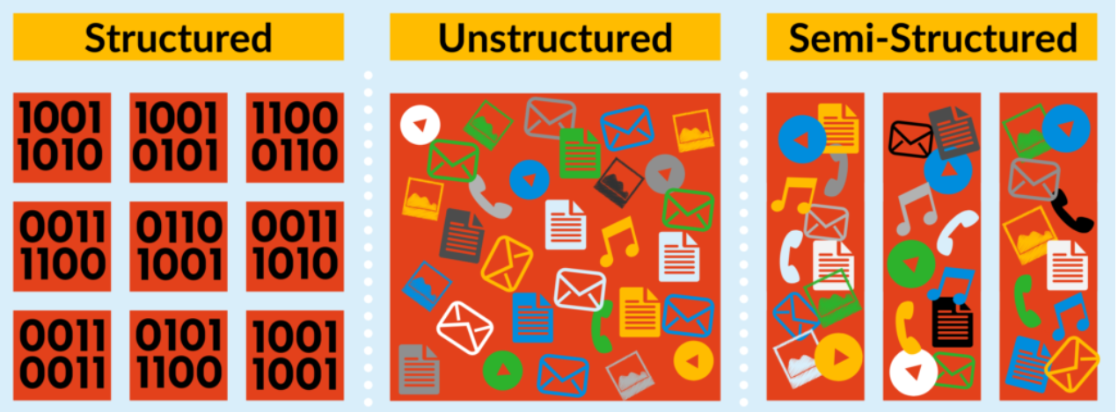
Big Data - Types of Big Data
Source: Select hub
Unstructured data is qualitative data that consists of audio, video, sensors, descriptions, and more.
Semi-structured data is a type of structured data that lies midway between structured and unstructured data. Common examples of semi-structured data are JSON and XML
Structured data is quantitative data that consists of numbers and values.

Slide 8
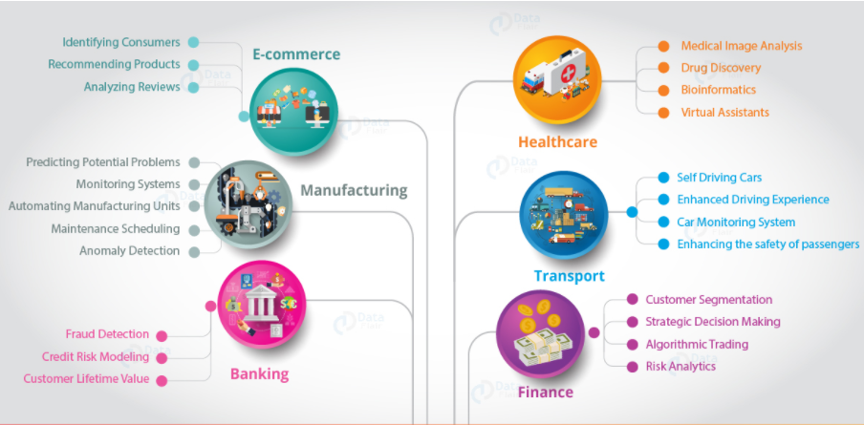
Business Applications - Data science has created a vast impact on all the applications
Source: Data Flair

Slide 9
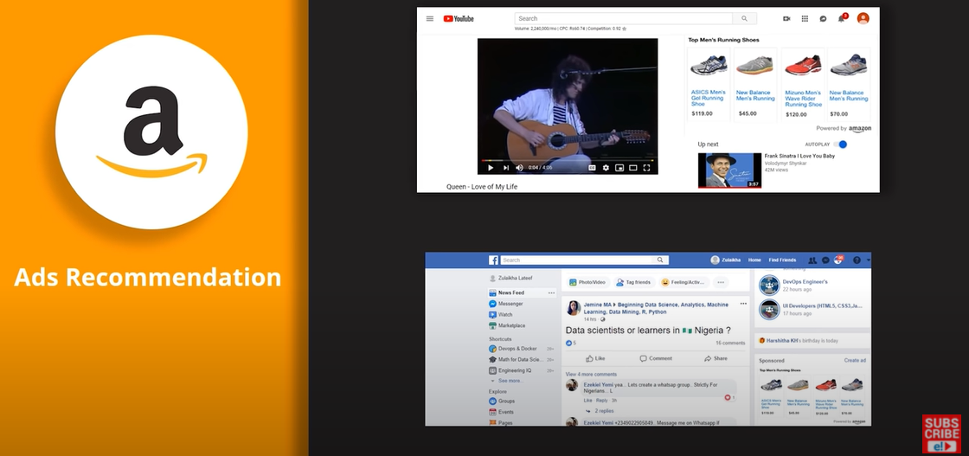
Business Applications – Amazon: Transforming E-commerce with Data Science
Suppose you look for shoes on amazon, but you don’t buy in there. Next day when you are watching video on YouTube and suddenly you see an ad for the same item you switch to Facebook there also you see the same ad so how does this happen? Because google tracks your search history and recommends ads based on your search history. This is one of the coolest application of data science. Infact 35% of amazon revenue is generated because of product recommendation and logic behind product recommendation is data science.
Source: Simplilearn

Slide 10
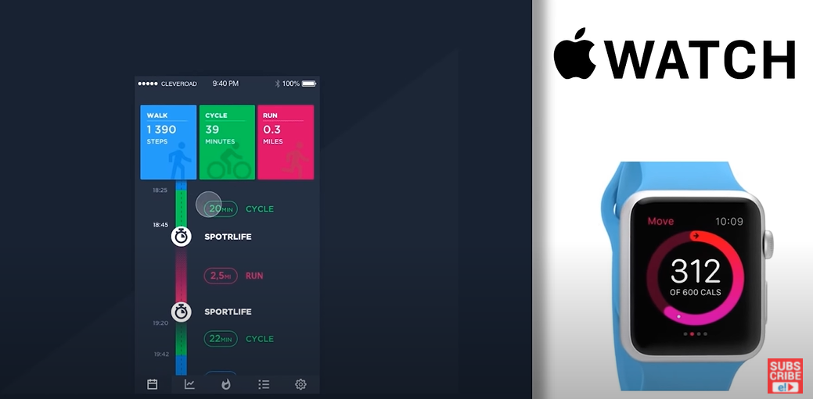
Business Applications – Apple: Smart Watch for healthy life
How could a watch detect heart attack?
Data Science at Apple
Monitor's health of an individual
Collects data such as heart rate, sleep cycle, breathing rate, activity level, blood pressure etc
Predicts the risk of heart attack
Source: Simplilearn

Slide 11
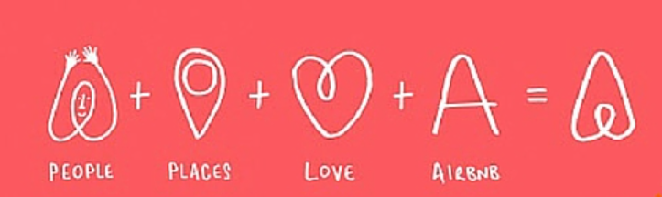
Business Applications – Airbnb: Using Data to Make Stays More Comfortable
It uses data to provide better search results to its customers. It makes use of demographic analytics to analyze bounce rates from their websites.
Airbnb makes use of knowledge graphs where the user’s preferences are matched with the various parameters to provide ideal lodgings and localities.
It has also optimized its search engine to provide better results to the customers and find compatible hosts.
Source: Zyre

Slide 12
Q&A

